Slide 1
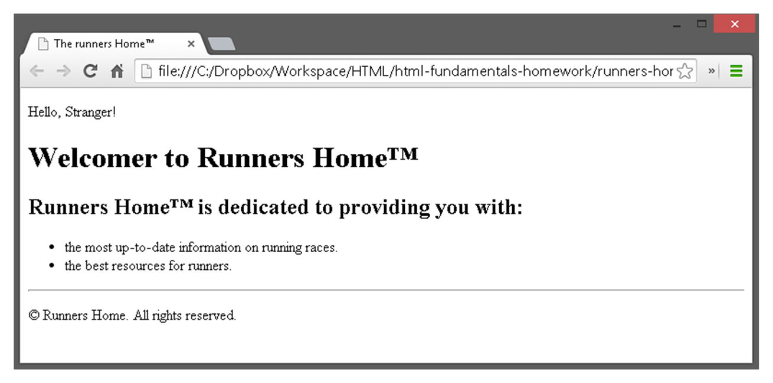
Exercises
Write an HTML page like the following:
* Use headings, divs, paragraphs and ul

Slide 2
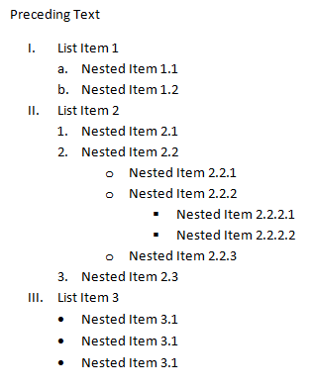
Exercises (2)
Write an HTML page like the following:

Slide 3
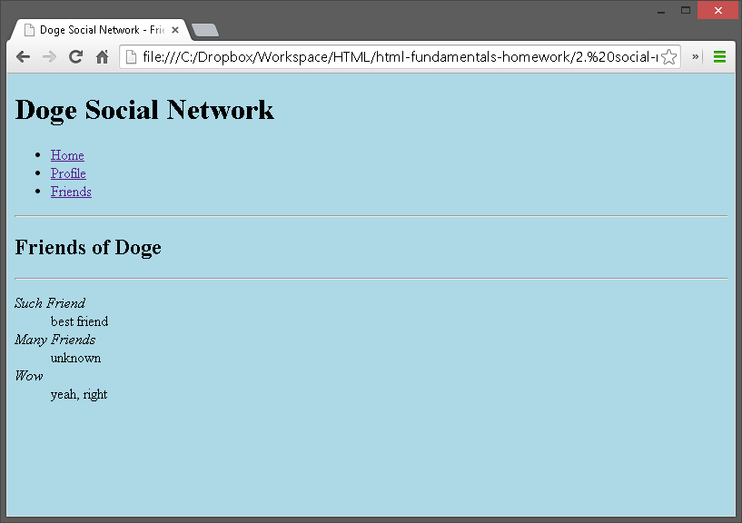
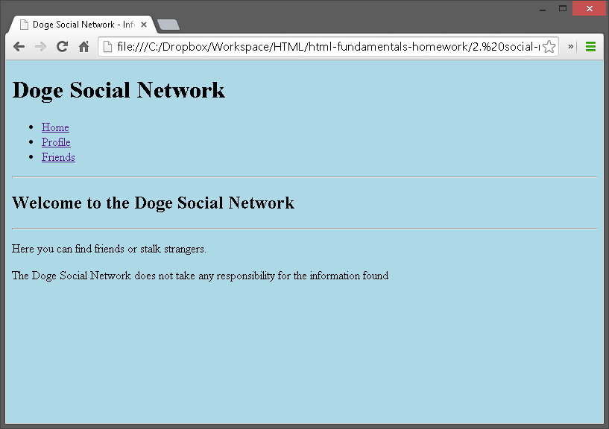
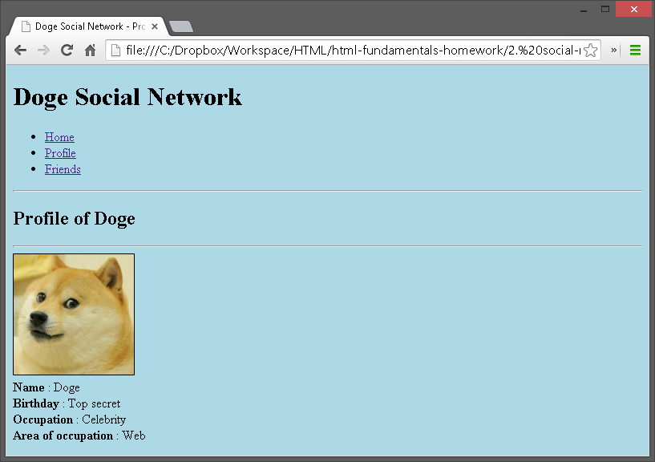
Exercises (3)
Create an user profile Web page profile.html, friends page named friends.html and info page named home.html. Link them to one another using <a> tag

